Slide 1
Cloud based personal health care platform
Minh Pham
Mostakim Tanjil
Yehenew Mengistu
Oklahoma State University

Slide 2
Problem ?
Access to healthcare from rural areas
Patients who bounce back frequently
Certain patients need to be monitored constantly

Slide 3
Solution !!
Development of a cloud monitoring system that remotely monitors patients 24/7
Smart medical garment embedded with EKG, Respiratory Band, Motion senor and SPO2
Real-time data upload to cloud
Classification of high risk signals
Notify physician

Slide 4
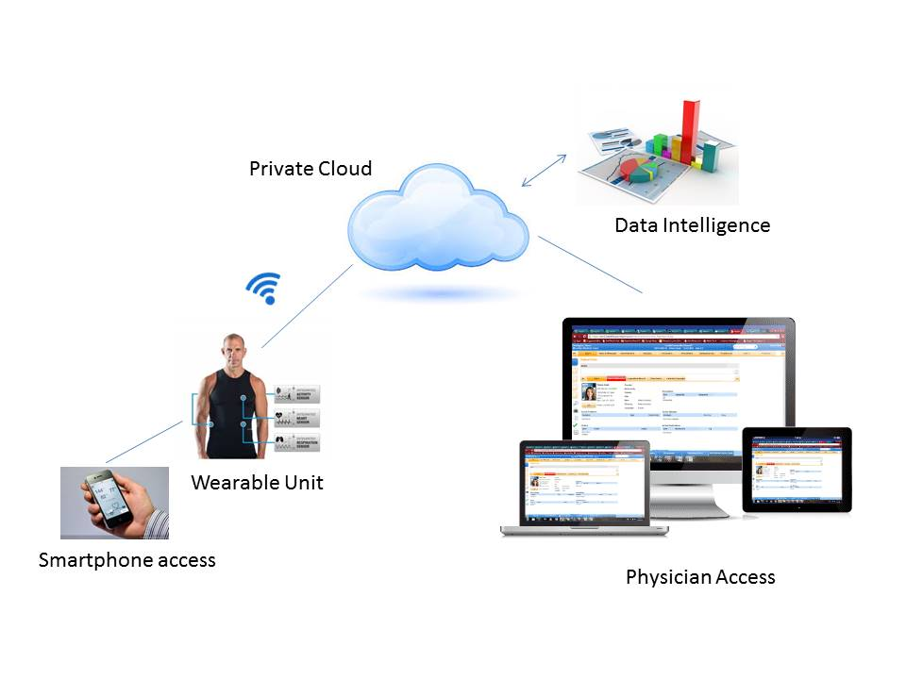
System Architecture

Slide 5
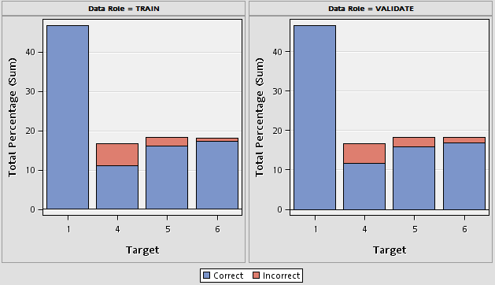
Human activity recognition
1 – Moving
4 – Sitting
5 –Lying and
6 – Standing
Accuracy of prediction algorithm
Moving – 100%
Sitting – 95.03%
Lying – 97.47%
Standing – 98.7%

Slide 6
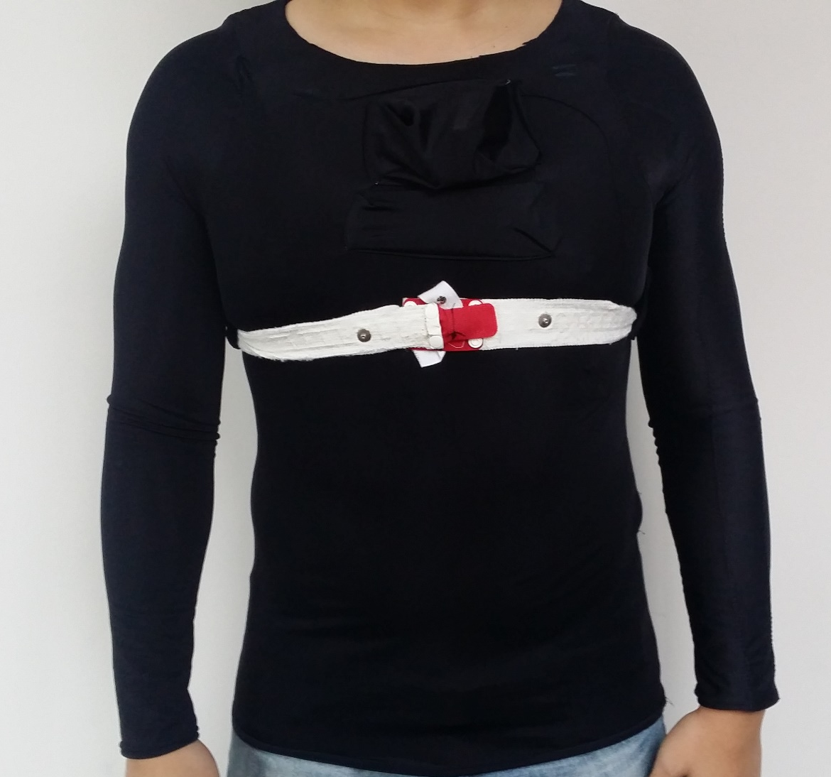
Design of Alpha Prototype

Slide 7
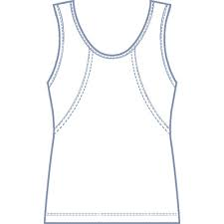
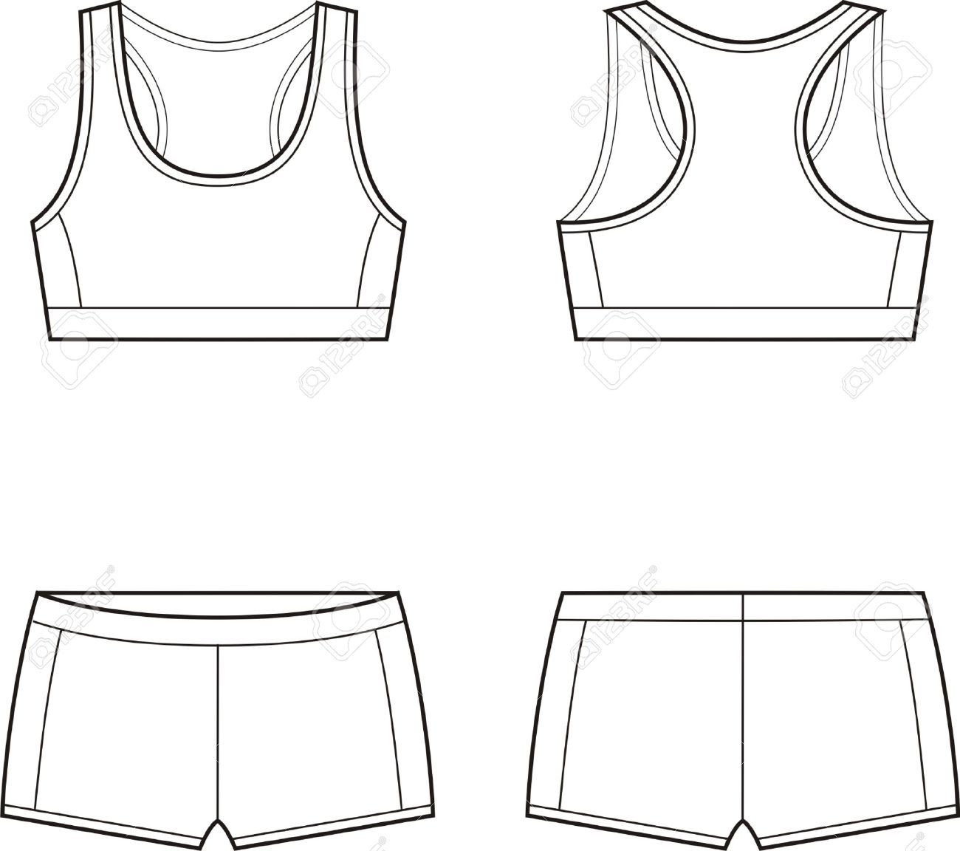
Design of Beta prototypes
ECG
Platform for electronics
For female
Respiration band
For male

Slide 8
Comparison
Product | Cost | Signal Quality | Intelligence | Washable | Wire integration | Comfort
Hexoskin | $399 | Good | No | Yes, without electronics | Integrated | Textile electrodes
Visi Mobile | Not available | Not compared | No | Yes, without cuff module | Not integrated | Adhesive electrodes
Alpha prototype | $340 (development) | Better than hexoskin | Yes | Yes, without electronics | Integrated | Textile electrodes

Slide 9
Business strategy
Product – Patent pending
FDA approval application
Target market
Physicians
Health insurance – Especially Medicare
End users
Elderly patients who needs continuous monitoring

Slide 10
Work in progress
The size of the box
New schematic diagram to reduce the size
Creating machine learning algorithms to detect cardiopulmonary diseases.

Slide 11
Live Demonstration of Alpha prototype
http://atrc-cloud10.atrc-ecen.okstate.edu/healthcare/

Slide 12
Thank you!

